Slide 1



LEAD: Localized Explanations with Adversarial Decision Boundary Characterization for Interpretable Disease Prediction
Asiful Arefeen, Hassan Ghasemzadeh
Embedded Machine Intelligence Lab
College of Health Solutions
Arizona State University
ghasemzadeh.com

Slide 2
What is Explainable AI (XAI)?
Explainable AI is a method of explaining the decision-making process of machine learning models
It answers what makes the model believe in a certain way and come to a classification/regression result
Instills trust and transparency in AI models. We get to know if a model is thinking the way it should
What is XAI | Motivations | Our proposal | Experiment | Results | Limitations

Slide 3
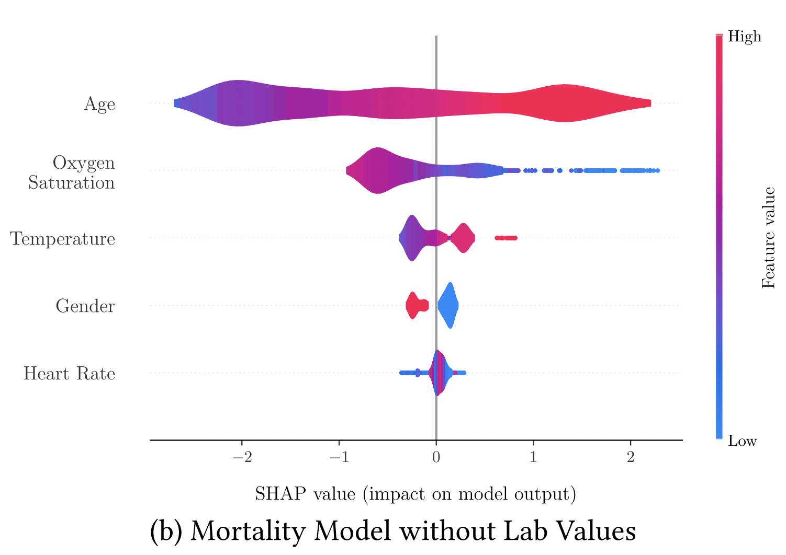
Example Explanations
Outcome of a popular XAI model, SHAP, on COVID mortality prediction model
Bertsimas, Dimitris et al. “From predictions to prescriptions: A data-driven response to COVID-19.” Health Care Management Science 24 (2020): 253 - 272.
What is XAI | Motivations | Our proposal | Experiment | Results | Limitations

Slide 4
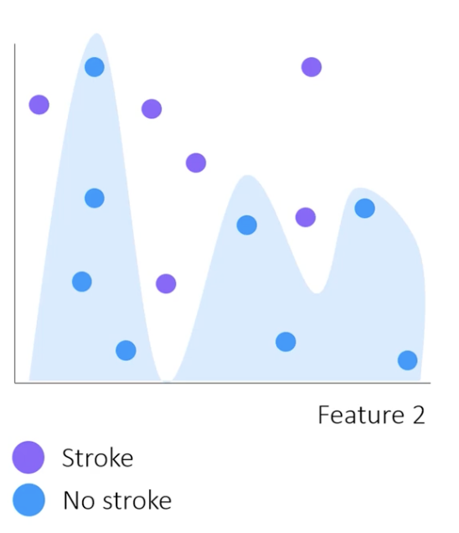
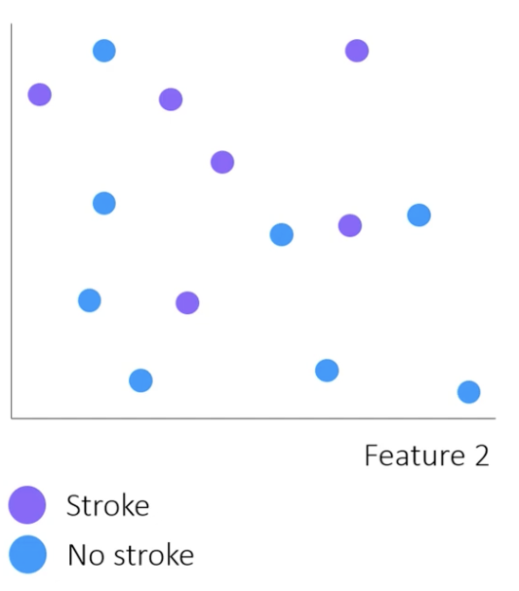
Motivations/problem with existing methods
LIME uses global model to label ‘local’ perturbed samples and train a simpler surrogate model
Surrogate model might be overly simplistic
Feature 1
Feature 1
Feature 1
What is XAI | Motivations | Our proposal | Experiment | Results | Limitations

Slide 5
Motivations/problem with existing methods
In general, perturbing samples that belong to a class can lead to interference between the features when estimating individual feature contribution
Feature 1
Feature 2
What is XAI | Motivations | Our proposal | Experiment | Results | Limitations

Slide 6

Motivations/problem with existing methods
Also, methods might be prone to adversarial attack which leads to impaired robustness
Feature 1
explanations
explanations
What is XAI | Motivations | Our proposal | Experiment | Results | Limitations

Slide 7
Our proposal
Instead of perturbing adversarial samples that already belong to a class, we propose to perturb samples that are neutral and placed along the decision boundary
Test sample
Feature 1 | Feature 2 | Feature 3 | …. | Feature f
perturb | fixed | fixed | fixed | fixed
k Nearest
critical samples
Perturb the critical samples and measure change in classification probability
What is XAI | Motivations | Our proposal | Experiment | Results | Limitations

Slide 8
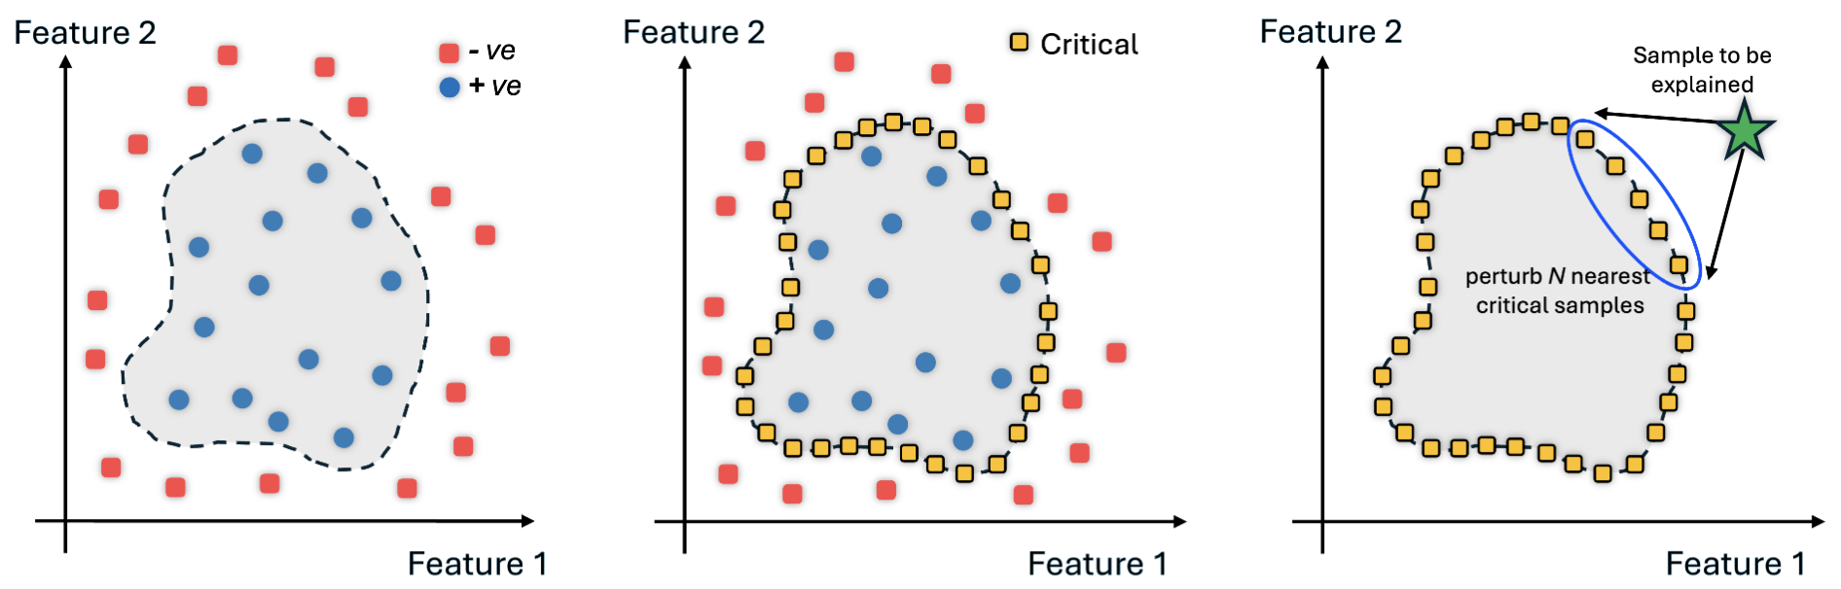
Generating the critical samples
Use autoencoders with custom loss function
AE
AE
$$minimize⁡[mse\left(x,\hat{x}\right)+α_{2}∗bce(\left[0,1\right],clf(\hat{x})]$$
$$minimize⁡[mse\left(x,\hat{x}\right)+α_{1}∗bce(\left[1,0\right],clf(\hat{x})]$$
What is XAI | Motivations | Our proposal | Experiment | Results | Limitations

Slide 9
Experiment
Data
Heart Disease
918 instances
4 categorical features
5 continuous features
Binary classification: heart disease (y = 1) or not (y = 0)
Our trained classifier (MLP) had 81.52% accuracy
Pima Diabetes
768 subjects
1 categorical and 7 continuous features
Binary classification: if a subject would have diabetes (y = 1) or not (y = 0)
Our trained classifier (MLP) had 80.86% accuracy
What is XAI | Motivations | Our proposal | Experiment | Results | Limitations

Slide 10
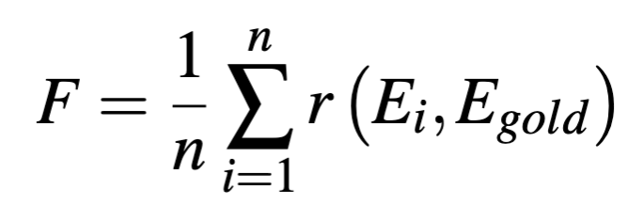
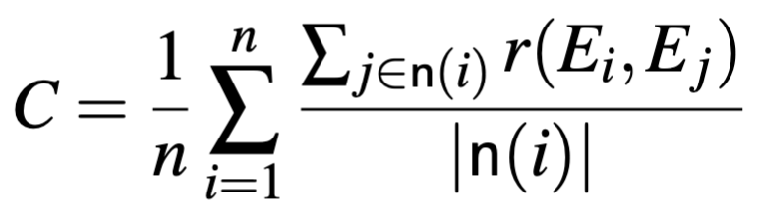
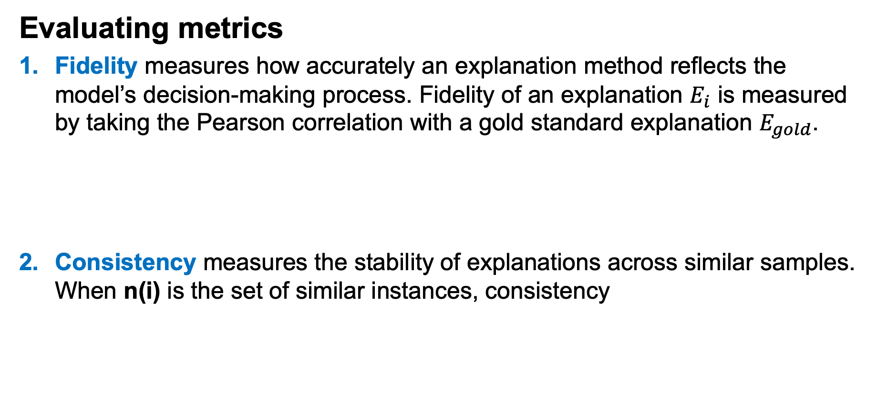
Metrics
Evaluating metrics
Fidelity measures how accurately an explanation method reflects the model’s decision-making process. Fidelity of an explanation $E_{i}$ is measured by taking the Pearson correlation with a gold standard explanation $E_{gold}$.
Consistency measures the stability of explanations across similar samples. When n(i) is the set of similar instances, consistency
Random forest explanations
What is XAI | Motivations | Our proposal | Experiment | Results | Limitations

Slide 11
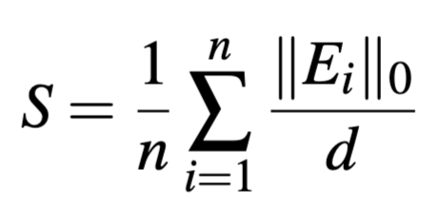
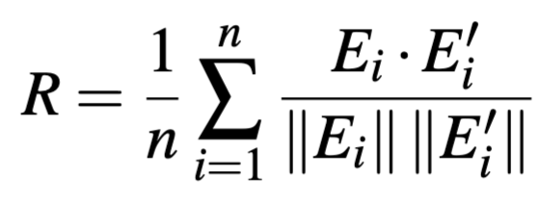
Metrics
Evaluating metrics
Sparsity determines how many features are zero (or nearly zero) in the explanation vector. A sparse explanation is often desirable as it means only a few features are considered important
Robustness refers to the stability of explanations when small, intentional and controlled perturbations are applied to the input data
What is XAI | Motivations | Our proposal | Experiment | Results | Limitations

Slide 12
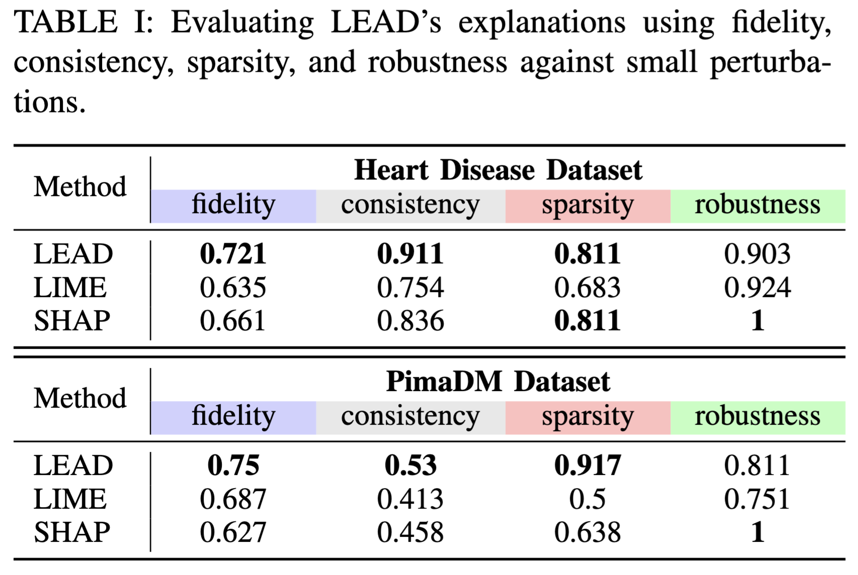
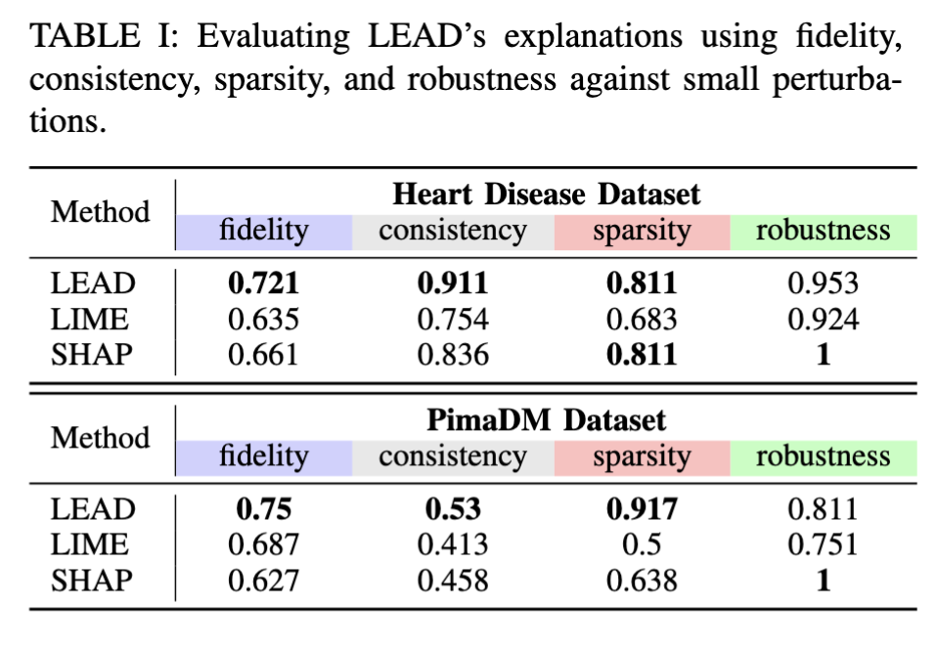
Results
What is XAI | Motivations | Our proposal | Experiment | Results | Limitations

Slide 13
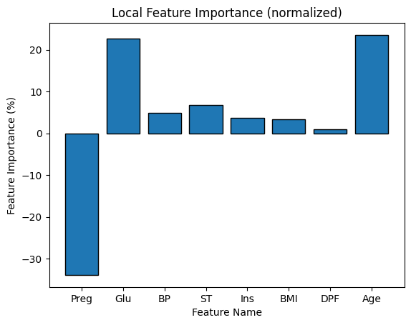
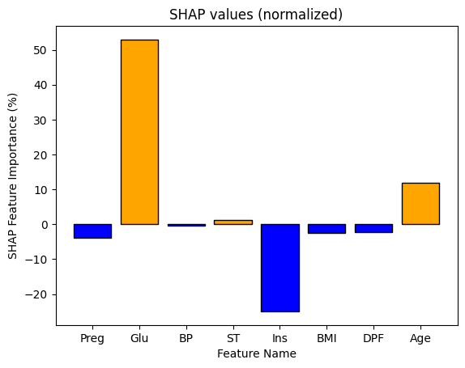
Results
Sample explanation
LEAD
SHAP
What is XAI | Motivations | Our proposal | Experiment | Results | Limitations

Slide 14
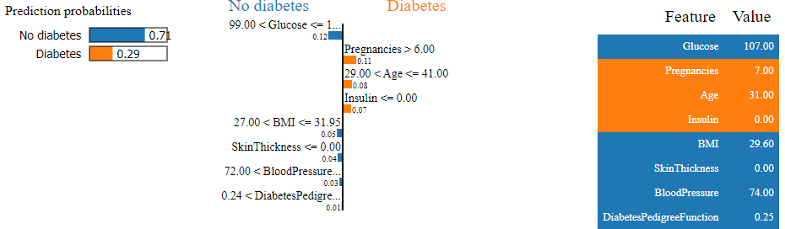
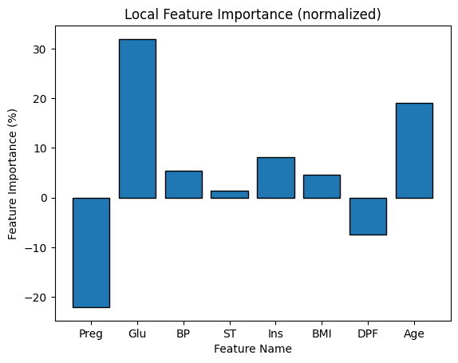
Results
Sample explanation
LEAD
LIME
What is XAI | Motivations | Our proposal | Experiment | Results | Limitations

Slide 15
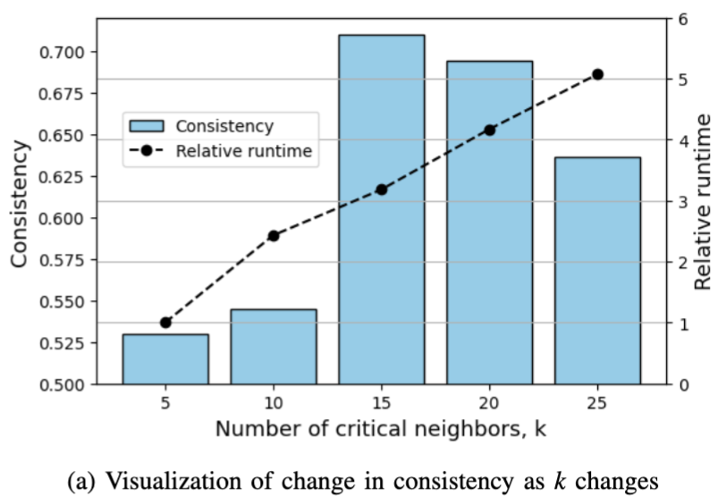
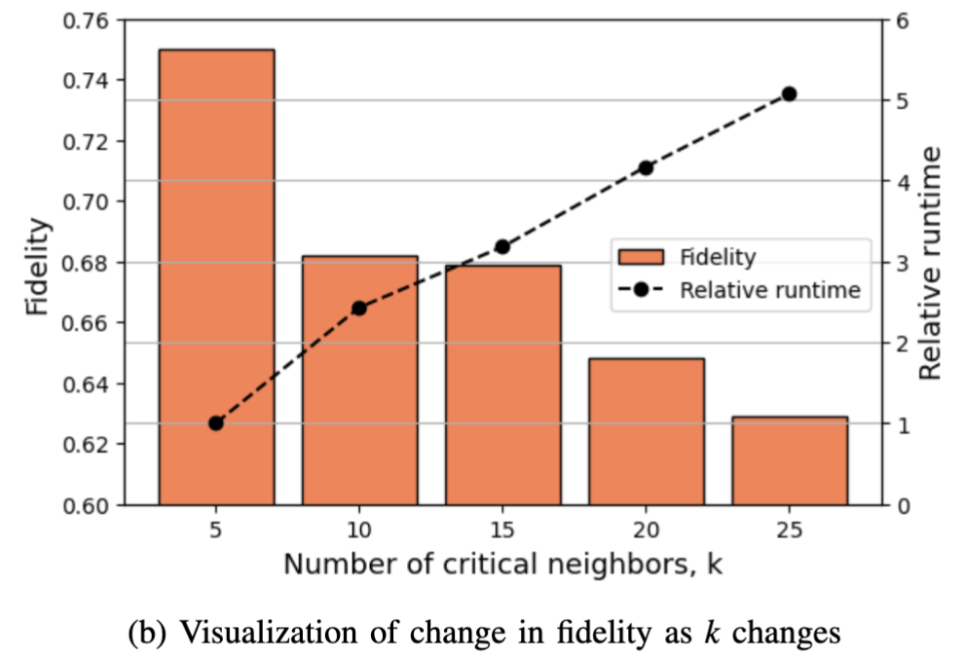
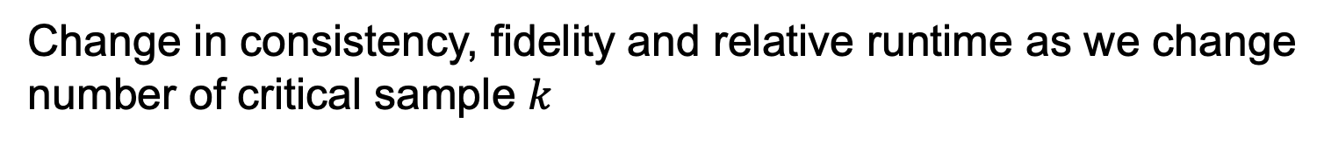
Ablation Study
Change in consistency, fidelity and relative runtime as we change
number of critical sample $k$
Test sample
k Nearest
critical samples
What is XAI | Motivations | Our proposal | Experiment | Results | Limitations

Slide 16
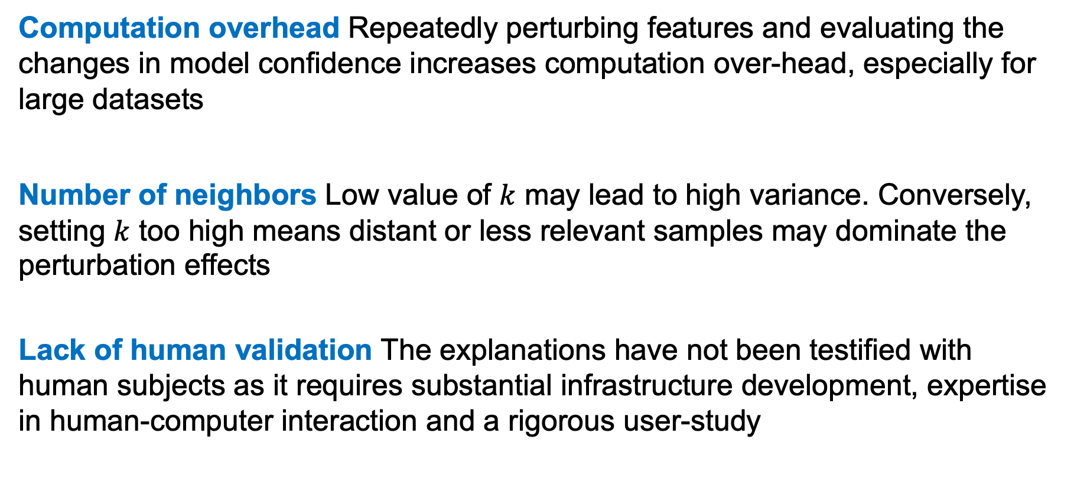
Limitations
Computation overhead Repeatedly perturbing features and evaluating the changes in model confidence increases computation over-head, especially for large datasets
Number of neighbors Low value of $k$ may lead to high variance. Conversely, setting $k$ too high means distant or less relevant samples may dominate the perturbation effects
Lack of human validation The explanations have not been testified with human subjects as it requires substantial infrastructure development, expertise in human-computer interaction and a rigorous user-study
What is XAI | Motivations | Our proposal | Experiment | Results | Limitations

Slide 17

Thank You!
aarefeen@asu.edu
asiful-arefeen.com
ghasemzadeh.com

